Slide 1

Dagu Thumper Controller
CSCE 4301 Project 2 Final Presentation
The American University in Cairo
Spring 2021

Slide 2
Outline
Recap
System Architecture
The Dagu Thumper
The Ultrasonic Sensor
Demonstration
Technical Challenges
Future Work

Slide 3
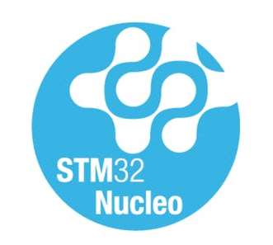
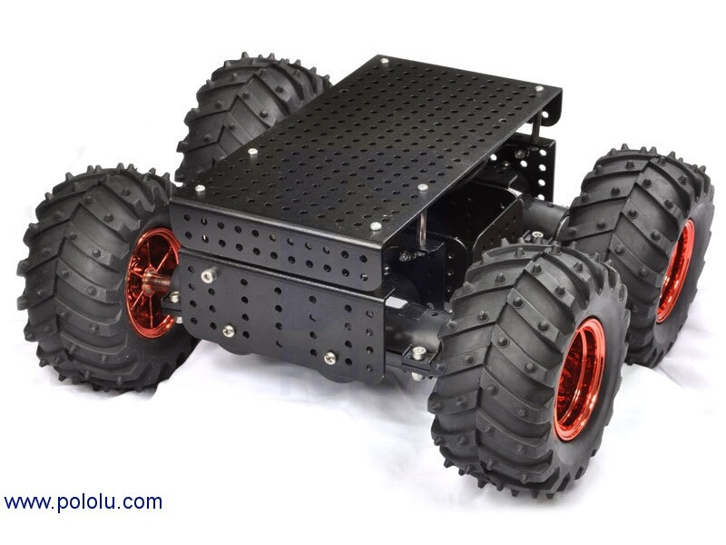
Recap
Dagu Thumper Controller
Remote Control
Collision Prevention using Ultrasonic Sensor
Speed Control
Notes:
u

Slide 4


Updated Design
HC-SR04
Rx
Tx
Sensor
Bluetooth
UART1
UART2
Bluetooth Terminal
Dagu Thumper
HM-10
STM32
μC
Input
Actuator

Slide 5
The Dagu Thumper & the Ultrasonic Sensor
HC-SR04
Rx
Tx
Sensor
Input
Ultrasonic Sensor Echo
Bluetooth UART commands
Output
Dagu Thumper movement based on commands
Speed Control
UART2
Dagu Thumper
STM32
Actuator

Slide 6
Demonstration

Slide 7

Technical challenges
Linking the Bluetooth module & the STM32 together using UART
Charging the Dagu Thumper battery
Making sure the commands are only sent to the Thumper once
Operating two simultaneous UARTs
Setting up speed control

Slide 8

Future Work
Setting up sensors on all sides to introduce spatial awareness
Introducing a self driving system, where the Thumper can navigate an area autonomously without colliding
Connecting camera to our System to allow for Remote control of the thumper
Emulate modern vehicles and implement a self parking system

Slide 9
Thank You!
Ashraf Ibrahim 900152964
Nourhan Moukbel 900162020
Saif El Din Abbas 900161322

